Slide 1
ENVIRONMENTAL POLLUTION DETECTION
Presented by:
Harini L
3rd Year CSE
Nm id :au421221104015
Gmail id: hariniharan0304@gmail.com

Slide 2
The escalating threat of environmental pollution poses significant challenges to human health, ecosystems, and sustainability. Traditional monitoring methods often lack efficiency, accuracy, and real-time data collection capabilities. There is a critical need for an advanced environmental pollution detection system that can accurately identify, monitor, and analyze various pollutants in air, water, and soil, providing timely insights for proactive mitigation and regulatory actions.
Problem statement:

Slide 3
Why we use cnn for environmental pollution detection:
Convolutional Neural Networks (CNNs) are commonly used for environmental pollution detection because they excel at analyzing visual data, such as images and videos. In environmental monitoring, CNNs can be trained to recognize patterns and features indicative of pollution, such as smoke, hazardous materials, or changes in vegetation health. By processing data from sensors, satellites, or cameras, CNNs can provide real-time or near-real-time analysis, helping to detect and monitor pollution levels, identify sources of contamination, and assess environmental impacts over large geographic areas. Additionally, CNNs can automate the analysis process, reducing the need for manual inspection and enabling more efficient and timely response to environmental threats.

Slide 4
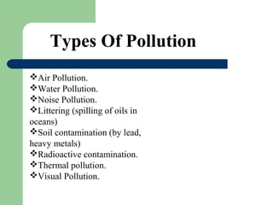

Slide 5
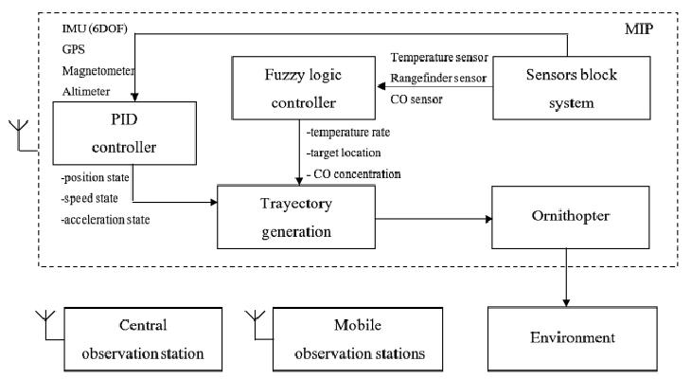
Proposed system:

Slide 6
System approach:
A system approach for environmental pollution detection involves integrating various components such as sensors, data collection mechanisms, data analysis algorithms, and decision-making frameworks. Here’s a breakdown of key components: Sensor Networks: Deploy sensors strategically in areas prone to pollution, including air quality sensors, water quality sensors, and soil sensors. Data Collection and Transmission: Use IoT devices to collect real-time data from the sensors and transmit it to a centralized database or cloud platform. This can involve wireless communication technologies like Wi-Fi, Bluetooth, or cellular networks. Data Processing and Analysis: Employ machine learning algorithms and data analytics techniques to process the collected data and identify patterns, trends, and anomalies indicative of pollution levels

Slide 7
Problem Forumalation:
Objectives: Clearly state the goals of the pollution detection system, such as: Identifying pollution sources and hotspots. Monitoring pollution levels in real-time. Providing early warning alerts for pollution events. Supporting decision-making for pollution mitigation measures.

Slide 8
Constraints and Challenges: Identify any constraints or challenges that need to be addressed, such as: Limited resources for deploying sensors and infrastructure. Data variability and uncertainty. Regulatory compliance requirements. Integration with existing monitoring systems and platforms.
Data Requirements: Specify the types of data needed for pollution detection, including: Sensor data (e.g., air quality measurements, water quality parameters). Geographic data (e.g., maps, land use data). Meteorological data (e.g., weather conditions, wind patterns).

Slide 9
Futures used for training:
Futures contracts could be used for training environmental pollution detection models by providing a simulated environment for testing and refining detection algorithms. These contracts could include data on various environmental factors such as air quality, water quality, and soil contamination levels, allowing researchers to train their models on a wide range of scenarios. Additionally, futures contracts could also incorporate data on weather patterns, industrial activities, and population density to create more accurate simulations of pollution levels in different areas. By using futures contracts for training, researchers can better understand how environmental factors interact and develop more robust detection models.

Slide 10
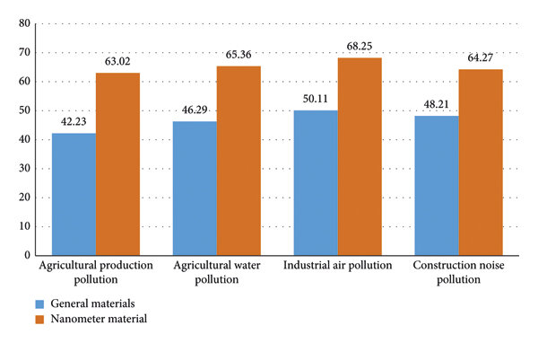
Results:

Slide 11
Conclusion:
In conclusion, effective environmental pollution detection is essential for safeguarding our planet and public health. By utilizing advanced technologies and comprehensive monitoring systems, we can identify pollutants accurately, assess their impacts, and implement timely interventions to mitigate pollution. Furthermore, fostering collaboration between governments, industries, and communities is crucial for achieving sustainable solutions and ensuring a cleaner, healthier environment for current and future generations.

Slide 12
Future works:
There are several potential future works for environmental pollution detection:Advanced Sensor Technology: Developing more sensitive and selective sensors capable of detecting a wider range of pollutants in real-time.Satellite Imaging: Leveraging satellite technology for continuous monitoring of pollution sources, such as industrial emissions, deforestation, and oil spills.Machine Learning and AI: Integrating machine learning algorithms to analyze large datasets collected from various sensors and sources to identify pollution patterns and predict future trends.

Slide 13
Reference:
Reference links for environmental pollution detection Environmental Protection Agency (EPA): The EPA website provides a wealth of information on various types of pollution detection methods and technologies. Website: https://www.epa.gov/ National Aeronautics and Space Administration (NASA): NASA conducts research and develops technologies for environmental monitoring and pollution detection, especially from space. Website: https://www.nasa.gov/ World Health Organization (WHO): The WHO provides resources and reports on environmental pollution and its impact on health, including detection methods. Website: https://www.who.int/

